Slide 1
Group 1
Bouhadan Imad, Dellafaille Lander, Mariën Levi, Pepermans Manu, Van de Mieroop Kevin

Slide 2

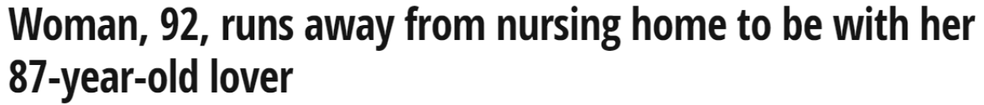

Introduction
Eldertrack
What is ElderTrack?
What can ElderTrack do for you?
Is ElderTrack worth buying?

Slide 3
Buildup of the project
Outdoor
Back-end
Indoor
LoRaWAN
DASH7
e-Compass
Parsing
Barometer
RSSI
GPS
ThingsBoard.io
Temperatuur
Fingerprinting

Slide 4
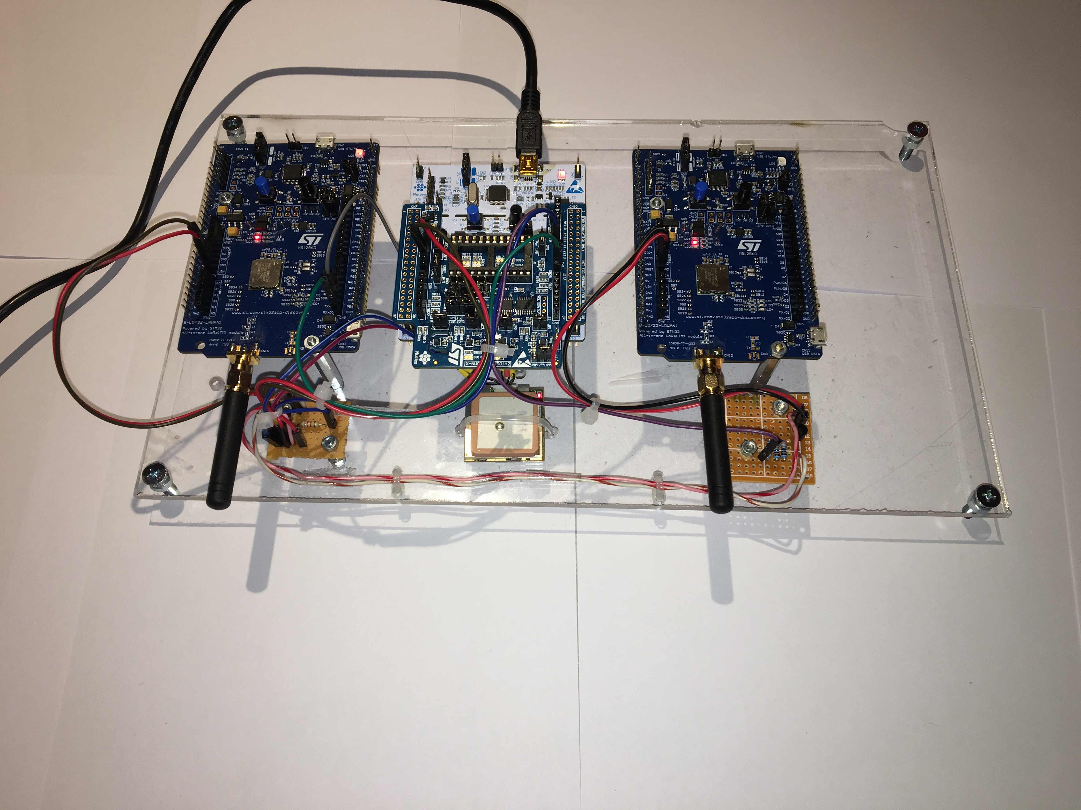
Physical implementation

Slide 5
Backend
Parsing
Lander

Slide 6
Backend
Thingsboard.IO
Lander

Slide 7
Fingerprinting
KNN-Algorithm & Database
Lander/Imad

Slide 8
Communication
DASH7
Manu

Slide 9
Communication
LoRAWAN
Manu

Slide 10
Indoor
Barometer & temperature
Imad

Slide 11
Outdoor
GPS
Manu

Slide 12
Outdoor
Ecompass
Levi

Slide 13
Implementation
Finite State Machine (FSM)
Manu

Slide 14
Implementation
Drivers
Levi

Slide 15
Documentation
Levi

Slide 16
Energy consumption
Low power features
Levi

Slide 17
Energy consumption
Estimation by CubeMX
Levi

Slide 18
Energy Consumption
Measured Energy consumption
Levi

Slide 19
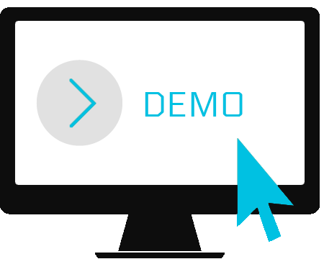
Demonstration

